Slide 1
Robust Geographical Incrementality Testing: An Ensemble Approach Integrating Machine Learning and Structural Equation Modeling
June 28, 2026

Slide 2
Introduction
This study proposes a multi‑stage causal framework that integrates observational causal discovery with density‑based stratification and triangulated causal estimation. Rather than matching blindly on pre‑period trends, the framework constrains the matching process using empirically derived causal priors to prevent structurally dissimilar markets from being paired. Standard geo-experiments rely on 'Greedy' algorithms to match test and control markets. But here is the problem: these algorithms assume all markets are fundamentally exchangeable—treating New York City and rural Montana as if they behave the same just because their revenue trends look similar for a few weeks. This assumption fails in the real world, introducing massive treatment effect heterogeneity bias that inflates variance, hides true ROI, and leads to wrong decisions and experiments.
The study introduces a four‑phase integrated pipeline: Stage 1: Discovery (Causal Priors): First, we use a panel Structural Equation Model (SEM) to uncover which media channels actually drive revenue. This gives us a Responsiveness Score per market—telling us exactly how sensitive New York is to Brand spend compared to Montana. Stage 2: Design (Stratified Matching): We use Weighted DBSCAN approach—a density-based clustering algorithm—to let the data naturally group markets into genuine cohorts. Crucially, we incorporate the SEM-derived Responsiveness Score as a weighted feature. We then run the standard Greedy matching algorithm, but we constrain it to operate strictly within each cohort. This prevents the algorithm from matching a large DMA with a small one—effectively 'de-biasing' the greedy approach at its core.
Stage 3: Validation (Safety Gates): Before spending a dollar on a live test, we simulate a synthetic intervention. This allows us to calculate the Minimum Detectable Effect (MDE) and run rigorous safety gates—AA tests, drift checks, and correlation thresholds—to guarantee the design is structurally sound. Stage 4: Analysis (Triangulated Estimation): To prevent algorithmic bias, we don't rely on just one model. We triangulate the incremental lift using three independent frameworks: Time Based Regression, Quantile Random Forest, and Bayesian Structural Time-Series. This ensemble gives us robust, decision-ready confidence intervals.

Slide 3
Introduction Key Take Aways
Phase | Action | Key Metric
1. Discovery | SEM -> Responsiveness Score (Causal Priors) | Identifies drivers without external instruments
2. Design | Weighted DBSCAN + Cluster-Constrained Greedy | Prevents cross-type matches
3. Validation | Simulate Test -> MDE & Safety Gates | Guarantees structural integrity
4. Analysis | Triangulated Ensemble (DiD + QRF + Bayesian) | 2-out-of-3 consensus for significance

Slide 4
Problem Statements Pt. 1
The Measurement Challenge in a Multi‑Channel Ecosystem:
The digital advertising ecosystem has evolved into a complex, multi‑channel environment where brands allocate significant budgets across search, social, and programmatic platforms. Measuring the true incremental return on ad spend (iROAS) has become the central challenge for modern marketing analytics. Traditional methods for measuring marketing success are flawed. They often ignore outside factors, struggle to track the complicated steps customers take before buying, and get confused by coincidences. Because of this, it's hard to tell if an ad actually caused a sale, or if the person was going to buy anyway.
The Shift to Randomized Geo‑Experiments: To overcome these observational limitations, the industry has increasingly turned to randomized geo‑based experiments. As Shaw (2025) articulates, geographic experiments—where the units of randomization are entire regions such as cities or Designated Market Areas—have emerged as a gold standard methodology. Such experiments are often preferred over individual‑level randomization because they are robust to network spillover effects and can be implemented without relying on sensitive user‑level data, which is increasingly restricted by privacy regulations.
The Vulnerability of "Greedy" Matching Designs: A critical bottleneck remains in the design phase of these experiments. Standard practice relies on "greedy" matching algorithms that pair test and control geos primarily based on pre‑period outcome similarity. However, as highlighted in recent methodological critiques, matching solely on historical revenue risks pairing fundamentally incompatible markets. Two geographic markets may exhibit coincidentally similar short‑term revenue trajectories while possessing vastly different underlying structural dynamics, such as population density, baseline ad‑sensitivity, or brand penetration.
In addition, the greedy algorithm is "myopic"—it iteratively selects the best control for the first treated geo and then discards the remaining controls from consideration. This means that a control geo that would have been an excellent match for a later treated geo is permanently excluded, unnecessarily reducing the donor pool and inflating variance.
The Impact of Treatment Effect Heterogeneity: This greedy matching approach implicitly assumes that treatment effects are homogeneous across all regions. In reality, according to Chen et al. (2021), response metrics across geographic regions are often "very heavy‑tailed due to geo heterogeneity." When algorithms inadvertently match these highly heterogeneous units, reliable estimation becomes difficult, severely inflating variance and undermining the experiment's statistical power.
Furthermore, applying traditional regression models to staggered rollouts under these heterogeneous conditions mathematically distorts results; as Callaway and Sant'Anna (2021) proved, it can mathematically subtract newly treated geos from already‑treated geos, creating "negative weights" that produce biased estimates.
Notes:
The Measurement Challenge in a Multi-Channel Ecosystem
Brands struggle to measure true incremental return on ad spend (iROAS) due to complex, multi-channel paths and external noise, making it difficult to distinguish ad-driven conversions from organic growth.
The Shift to Randomized Geo-Experiments
To mitigate privacy concerns and spillover effects, the industry increasingly uses geo-based experiments, treating entire regions as randomized units. This approach is widely considered the gold standard for robust measurement.
The Vulnerability of "Greedy" Matching Designs
Standard "greedy" matching algorithms often fail by prioritizing short-term revenue similarity over structural compatibility (e.g., demographics, ad-sensitivity). Furthermore, their "myopic" nature—sequentially locking in matches—discards viable donor units, unnecessarily inflating variance.
The Impact of Treatment Effect Heterogeneity
Greedy matching assumes homogeneous treatment effects, ignoring the reality that regional responses are often "heavy-tailed." When algorithms pair incompatible units, estimation variance increases, undermining statistical power. Moreover, applying traditional regression to staggered rollouts in these conditions creates "negative weights," leading to biased results as documented by Callaway and Sant'Anna (2021).
The Verifiability Deficit (Addressing Transparency): Stakeholders distrust unverified results. Current bias correction methods use hidden "intent proxies." When a model attributes sales to an unobservable channel (e.g., Paid Social Meta Ads), users perceive "Allocative Harm" (inflated attribution). Lacking a verifiable ground truth, users remain skeptical.
Incongruence with Expert Mental Models (Addressing Interference): "Black Box" models frequently contradict expert domain knowledge, resulting in inconsistencies. For example, experts know pausing spend in one region causes budget interference (spillover) elsewhere—a physical constraint standard observational models miss. When a model output defies known market physics, the cognitive dissonance erodes expert confidence, causing rejection of even valid insights.
The Strategic-Tactical Disconnect (Addressing Actionability): MMM provides strategic insights but fail to translate high-level strategy into granular campaign execution, leading users to abandon the model's guidance during implementation. This renders the expensive AI system operationally useless for tactical decision-making.
Perceived Instability via Mathematical Uncertainty: Model instability, stemming from mathematical issues that results in erratic budget recommendations to non-technical stakeholders. This perceived volatility triggers “Algorithm Aversion”, leading decision-makers to revert to less accurate but reliable human heuristics.
Callaway, B., & Sant'Anna, P. H. C. (2021). Difference-in-differences with multiple time periods. Journal of Econometrics, 225(2), 200-230.
Chen, A., Longfils, M., & Remy, N. (2021). Trimmed Match Design for Randomized Paired Geo Experiments. Google Research.
Chen, A., & Au, T. C. (2021). Robust Causal Inference for Incremental Return on Ad Spend with Randomized Paired Geo Experiments. Google Research.
Rolnick, D., Aydin, K., Pouget-Abadie, J., Kamali, S., Mirrokni, V., & Najmi, A. (2019). Randomized experimental design via geographic clustering. Proceedings of the 25th ACM SIGKDD International Conference on Knowledge Discovery & Data Mining, 2745-2753.
Zhou, L., Zhang, Q., & Yuan, Y. (2019). Multisource data fusion in internet advertising with machine learning models. IEEE Transactions on Industrial Informatics, 15(12), 6566-6574.

Slide 5
Problem Statements Pt. 2
The Missing Link of Statistical Feasibility: An equally critical problem occurs before the experiment is launched. Marketing teams often set budgets and test durations arbitrarily, without knowing whether their planned spend is even large enough to generate a statistically detectable signal. As emphasized in recent causal machine learning literature, understanding how variables like experiment length and the magnitude of ad spend differentials impact the uncertainty of the measurement is a crucial prerequisite for effective design (Huber, 2024).
Without a rigorous pre‑experiment simulation, teams risk:
Underpowered tests: The budget is too small to overcome natural market noise, resulting in inconclusive p‑values and wasted spend.
Overpowered tests: The budget is unnecessarily large, wasting capital that could have been allocated elsewhere.
Structural failure: The matched markets organically drift apart during the test period due to unobserved, time-varying confounders. This violates the foundational parallel trends assumption required for causal inference, rendering the synthetic counterfactual invalid (Arkhangelsky et al., 2021). Tragically, standard methodologies only uncover this structural divergence post-mortem, after the money has already been spent.
There is no sandbox that simulates the synthetic intervention, calculates the Minimum Detectable Effect (MDE) against pre‑defined statistical thresholds (α, power), and runs safety gates (AA tests, drift checks, correlation diagnostics) before the live test begins. Consequently, teams fly blind into expensive experiments.
The "Which Model is Right?" Dilemma A third problem emerges after the experiment concludes: the choice of estimation framework. Practitioners typically rely on a single model—be it regression, a tree-based model, or a Bayesian structural model. However, each framework has distinct assumptions:
Regression: Parallel trends. It fails when pre‑period trends are noisy or non‑linear.
Tree-Based Model: It requires sufficient historical data. It fails when data is limited or the control pool is small.
Bayesian Structural Model: It requires structural stability. It fails when the pre‑period is too short or the counterfactual is unstable, as it requires good prior knowledge.
If the chosen model happens to fail its underlying assumption for the specific geo‑experiment, the resulting lift estimate is biased—yet the practitioner has no way of knowing this without comparing against alternative models. There is no built‑in mechanism to triangulate estimates and determine whether multiple independent models converge on a consensus. Relying on a single model risks algorithmic bias and undermines confidence in the final budget decision.
Notes:
Arkhangelsky, D., Athey, S., Hirshberg, D. A., Imbens, G. W., & Wager, S. (2021). Synthetic difference-in-differences. The American Economic Review, 111(12), 4088-4118. (Use this to cite the challenges of time-varying confounders and the failure of parallel trends in standard control frameworks).
Huber, M. (2024). Causal Machine Learning and its adoption in marketing. (Use this to cite the importance of rigorous causal ML frameworks and heterogeneity analysis as a prerequisite in modern experimental design).

Slide 6
The Three Core Problems This Study Addresses
Phase | Problem | Consequence
Design | Greedy matching on pre‑period outcomes | Pairs structurally dissimilar markets → Heterogeneity bias
Design | Discarding of controls after matching | Wastes good donors, inflates variance, reduces statistical power
Design | Assumption of homogeneous treatment effects | Fails in real‑world heavy‑tailed distributions (Chen et al., 2021)
Design | Ignoring causal priors in historical data | Missed opportunity to improve stratification with structural knowledge
Validation | No pre‑experiment simulation or safety gates | Underpowered tests, arbitrary budgets, undetected structural drift
Validation | No Minimum Detectable Effect (MDE) calculation | Teams fly blind into expensive live experiments
Analysis | Reliance on a single estimation framework | Algorithmic bias—DiD, QRF, or Bayesian may each fail under different conditions
Analysis | No triangulation or consensus mechanism | Inability to distinguish signal from model‑specific artifacts

Slide 7
Problem Statements: Key Takeaways
Existing methods often disregard rich causal information present in historical data. Modern methodological updates propose grouping regions based on their latent structural identity rather than coincidental revenue trajectories. By matching high‑responsiveness geos with structurally similar peers, they react to external economic shocks in the same way, ensuring the counterfactual holds true throughout the entirety of the treatment period.
This study addresses that missed opportunity. Rather than matching blindly on short‑term trends, we inject empirically derived causal priors—obtained from a Structural Equation Model (SEM)—into the stratification process. By weighting the density‑based clustering with these priors and constraining the greedy matching to operate within each resulting cohort, we prevent cross‑type matches and systematically reduce treatment effect heterogeneity bias. In addition, this study also addresses two additional gaps: the validation gap (no pre‑experiment simulation to confirm statistical feasibility) and the analysis gap (reliance on a single model without triangulation). Overall, this study addresses all three gaps through a unified 4‑stage pipeline:
Gap | Our Solution
Design | Inject empirically derived causal priors (SEM) into DBSCAN stratification; constrain greedy matching to operate within homogeneous cohorts
Validation | Simulate synthetic intervention to calculate MDE against α=0.10, power=0.80; run AA tests, drift checks, and correlation diagnostics before live spend
Analysis | Triangulate lift estimates using Frequentist DiD, Quantile Random Forest (QRF), and Bayesian Structural Time‑Series (CausalImpact); 2‑out‑of‑3 consensus rule determines statistical significance

Slide 8
Objective of the Study
The primary objective of this study is to develop and empirically validate a robust, replicable causal framework for designing, evaluating, and measuring geo‑experiments that reduces matching bias and enhances the precision of incremental lift estimation.
The specific objectives are:
To identify causal media pathways and generate market‑specific responsiveness priors: Estimate a panel SEM with fixed effects to map the causal influence of media channels (e.g., brand, demand generation, PMax) on revenue, and derive a "responsiveness score" for each geo to be used in the design phase.
To stratify geographic markets into internally homogeneous cohorts: Implement a weighted DBSCAN algorithm utilizing correlation distance (metric='correlation', eps=0.10) and SEM‑derived feature weights to objectively cluster DMAs based on revenue, visits, orders, and the responsiveness priors, while isolating volatile outliers (noise).
To develop a cluster‑constrained greedy matching protocol: Integrate Google's Matched Markets algorithm but constrain the search to operate strictly within the DBSCAN‑derived cohorts, preventing cross‑type mismatches and systematically reducing treatment effect heterogeneity bias.
To establish a validation and power analysis protocol: Simulate a synthetic intervention to compute the Minimum Detectable Effect (MDE) against pre‑determined statistical thresholds (α=0.10, power=0.80), utilizing AA tests, drift checks, correlation diagnostics, and pre‑period model fit metrics (RMSE, R²) to certify design integrity before live execution.
To triangulate causal lift estimation: Compare and contrast the incremental revenue estimates generated by three distinct modeling frameworks—Time-Based Regression, Quantile Random Forest (QRF), and Bayesian Structural Time‑Series —using a 2‑out‑of‑3 voting rule to validate results and provide robust, decision‑ready confidence intervals.
To assess the generalizability and limitations: Conduct sensitivity analyses across varying pre‑test and post‑test windows, and characterize the differences between retained dense DMAs and discarded volatile DMAs to define the scope of external validity.

Slide 9
Mapping Objectives to Problem Statements
Problem Statement Gap | Corresponding Objective
Greedy matching ignores causal priors | Objective 1 + 2 + 3
No pre‑experiment simulation or safety gates | Objective 4
Single‑model reliance, no triangulation | Objective 5
Generalizability limitations unknown | Objective 6

Slide 10


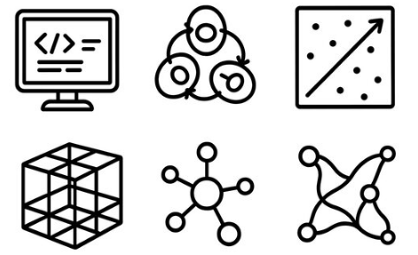


The End-to-End Study Work Flow Ecosystem
A unified, minimal human interference architecture bridging Applied Computing and Strategic Execution.
1. Discovery
SEM dynamically maps cross-channel causal influence.
2. Design
Stratified DBSCAN clustering objectively matches homogenous markets.
3. Simulation
Power Analysis thru synthetic Data Injection
4. Validation
Safety Gates (A/A, Drift) verify structural integrity.
5. Analysis
Triangulated Causal Estimation that calculates exact incremental ROI & exports playbooks.
Notes:
To conclude, this is the complete, end-to-end causal ecosystem. By orchestrating these five distinct computational steps into a single, zero-touch dashboard, we have effectively solved the explainability gap. We move from initial discovery with SEM, to objective market matching, through predictive simulation and rigorous safety gates, all the way to final econometric analysis. This architecture ensures that strategic media planners can launch complex, mathematically sound financial experiments without ever touching a line of code or a vulnerable spreadsheet. Thank you.

Slide 11
Study Workflow
The study is operationalized through a linear, five‑stage methodological workflow that transitions from discovery to actionability.
Stage | Title | Methodology | Key Output
1 | Discovery | Panel SEM with Fixed Effects: Maps cross‑channel causal pathways to produce a geo‑level responsiveness prior (total effect coefficient) without relying on external instruments. | Causal priors for media channels; Geo‑level responsiveness scores.
2 | Design | Weighted DBSCAN (Correlation Distance): Applies metric='correlation', eps=0.10 (r > 0.90), and SEM‑derived empirical feature weights to create dense cohorts while isolating noise. Cluster‑Constrained Greedy Matching: Executes Google Matched Markets independently within each cohort to select test/control pairs, preventing cross‑type matches. | Homogeneous geo cohorts (Dense DMAs retained); Matched test/control pairs.
3 | Simulation | Synthetic Data Injection: Imposes a known "true" lift (e.g., ±$45,000) onto the matched design to simulate the test period and calculate the Minimum Detectable Effect (MDE) against α=0.10 and power=0.80. | Power analysis (MDE); Simulated ground truth for validation.
4 | Validation | Safety Gates & Diagnostics: Runs AA tests, drift checks, correlation diagnostics, and pre‑period model fit metrics (RMSE, R²) to ensure structural integrity of the counterfactual before live execution. | Model diagnostics (RMSE, MAPE); Stability Analysis.
5 | Analysis | Triangulated Causal Estimation: Applies Time-Based Regression, Machine Learning (QRF), and Bayesian Structural Time‑Series (CausalImpact) to the post‑period data. Ensemble uses a 2‑out‑of‑3 consensus rule to determine statistical significance. | 90% Confidence Intervals; Statistical significance verdict; Strategic Playbook (Budget & ROI Recommendation).

Slide 12
Significance of the Study
This research makes the distinct contributions to the causal inference and marketing science literature:
Bridging Observational Priors and Experimental Design: It empirically demonstrates that causal information derived from pre‑experiment observational data (SEM) can be systematically transferred to improve the stratification and matching of geo‑experiments, providing a formal bridge between correlational MMM and experimental lift studies.
De‑biasing the Greedy Algorithm: By constraining greedy matching within DBSCAN cohorts, the study formally addresses the "treatment effect heterogeneity" problem that plagues standard synthetic control designs. It provides a replicable algorithm for ensuring that matched markets are not only similar in outcome trends but also in structural responsiveness to media.
Methodological Triangulation: The ensemble approach (DiD, QRF, CausalImpact) offers a novel robustness framework for marketing science, moving away from single‑point estimates and toward "consensus‑based" causal inference.
Budget Optimization: By ensuring a 2.5x iROAS detection capability with high confidence, the framework allows marketers to confidently scale or reduce channel investments. The simulation confirms that the signal (estimated lift) penetrates natural market noise, reducing the risk of misallocating multi‑million dollar budgets.
Credibility in Measurement: The triangulation framework provides leadership with high‑certainty evidence. The Bayesian tail‑area p‑value (p < 0.01) and the narrow 95% confidence intervals offer robust defense against skepticism regarding "ad waste."

Slide 13
Methodology

Slide 14
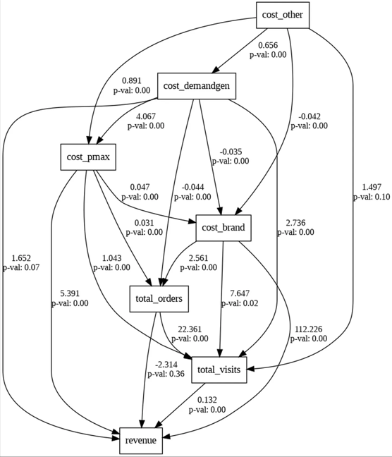
Step 1 – Causal Discovery (SEM)
Structural Equation Modeling (SEM) dynamically maps how different paid media channels influence each other.
This allows us to visually validate causal assumptions before committing budget, guaranteeing we select the channel providing the cleanest incremental signal.
Notes:
Structural Equation Modeling (SEM) dynamically maps how different paid media channels influence each other.
This allows us to visually validate causal assumptions before committing budget, guaranteeing we select the channel providing the cleanest incremental signal.

Slide 15
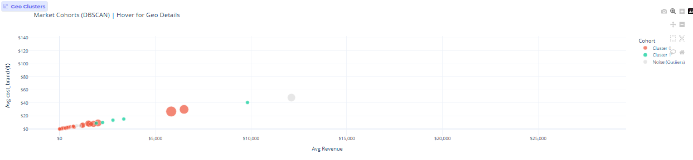
Step 2 – Market Clustering (DBSCAN)
Clustering automates objective market selection, effectively addressing geographic heterogeneity.
The algorithm mathematically groups regions based on historical trajectories, expenditure, and temporal patterns to ensure available control markets are perfectly homogenous twins.
Notes:
K-Means clustering automates objective market selection, effectively addressing geographic heterogeneity.
The algorithm mathematically groups regions based on historical trajectories, expenditure, and temporal patterns to ensure available control markets are perfectly homogenous twins.

Slide 16
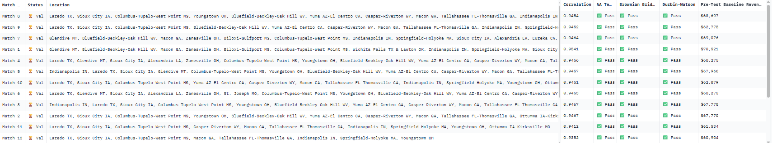
Step 3 – Safety & Execution
Algorithmic gatekeepers force the design through rigorous validation before generating the Execution Playbook.
The system automatically executes A/A Placebo tests, scans for autocorrelation via Durbin-Watson, and monitors model drift using Brownian Bridge diagnostics.
Notes:
The final step acts as a statistical safety net. Before generating the final Execution Playbook, the dashboard forces the design through algorithmic gatekeepers. It automatically runs A/A Placebo tests, scans for autocorrelation via Durbin-Watson, and monitors model drift using Brownian Bridge. The result is a foolproof interface that translates dense econometric theory into a safe, actionable strategy.

Slide 17
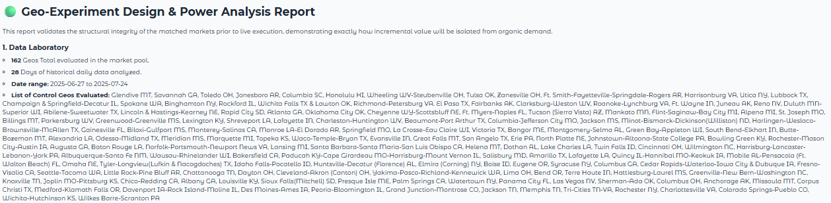
Step 4 – Recommendation Analysis
Notes:
Finally, Step 5 automates the post-test analysis. Once the physical experiment concludes, the system ingests the data and runs a Time-Based Regression (TBR) to calculate the true incremental lift against our modeled counterfactual. Crucially, it translates these complex econometric outputs—including 90% confidence intervals—into executive-ready visual waterfalls and cumulative lift charts. This instantly proves the final ROI, closing the loop from our initial causal hypothesis to a verified, mathematically sound financial return.

Slide 18
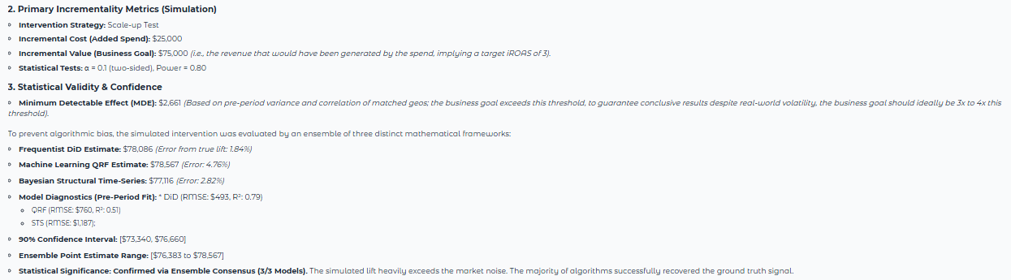
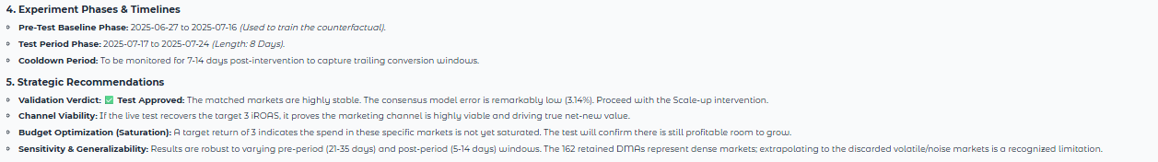
Step 5 – Recommendation Analysis
Notes:
Finally, Step 5 automates the post-test analysis. Once the physical experiment concludes, the system ingests the data and runs a Time-Based Regression (TBR) to calculate the true incremental lift against our modeled counterfactual. Crucially, it translates these complex econometric outputs—including 90% confidence intervals—into executive-ready visual waterfalls and cumulative lift charts. This instantly proves the final ROI, closing the loop from our initial causal hypothesis to a verified, mathematically sound financial return.

Slide 19
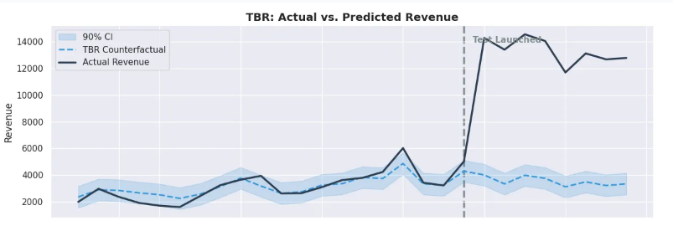
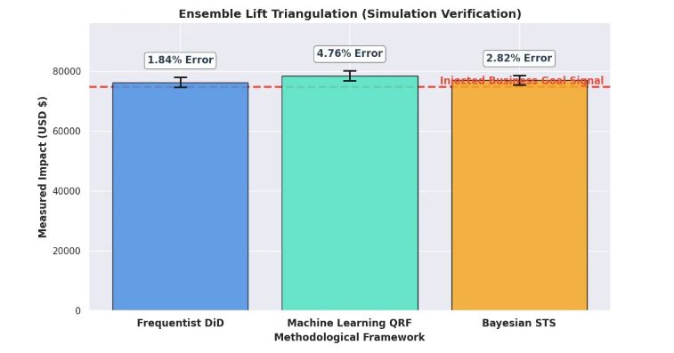
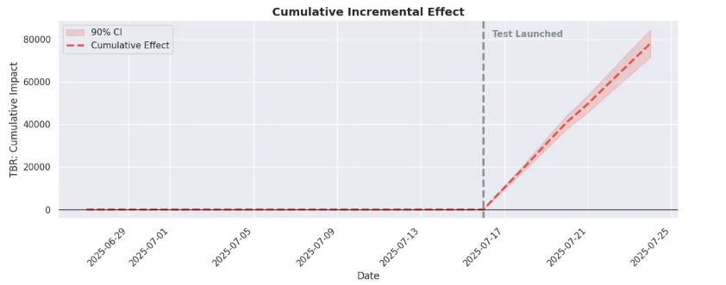
Step 6 – Recommendation Analysis

Slide 20
Related Studies

Slide 21
Related Studies On Heterogeneity & Matching Pt. 1
Author & Study Focus | Paper Summary | Methodological Weakness | How the Study Resolves It
Chen & Au (2021) Trimmed Match Design Chen, Aiyou & Longfils, Marco & Remy, Nicolas. (2021). Trimmed Match Design for Randomized Paired Geo Experiments. 10.48550/arXiv.2105.07060. | Acknowledges geo-heterogeneity is extreme. Proposes mathematically "trimming" (deleting) data that doesn't fit into neat pairs. | While Trimmed Match provides a robust statistical estimator in theory, its practical implementation presents a critical vulnerability. Standard algorithmic applications of this method almost exclusively rely on univariate, pre-treatment response trajectories (e.g., historical revenue and ad spend) to calculate the distance matrix between geos. | The proposed study resolves this vulnerability by shifting the experimental design paradigm from univariate trajectory matching to multivariate structural clustering. Rather than pairing geos based on coincidental historical outputs, this study maps the true latent topology of the market. First, a panel Structural Equation Model (SEM) isolates channel-specific causal pathways, generating a true "responsiveness prior" for each geo. Second, this causal prior is combined with structural covariates (e.g., volume, lag effects) and passed into an HDBSCAN (Hierarchical Density-Based Spatial Clustering of Applications with Noise) algorithm.
Gordaliza et al. (2019) Optimal Trimmed Matching Gordaliza, Paula & Inouzhe, Hristo. (2023). Making Data Fair Through Optimal Trimmed Matching. 10.1007/978-3-031-15509-3_26. | Gordaliza points out a major mathematical flaw: that not all individuals across groups are comparable. Due to historical or societal factors, Group A might have drastically different baseline covariates than Group B. If we simply compare the raw outcomes, we might confuse "genuine differences in baseline data" with "algorithmic bias". The study explores trimming to force "fairness" and covariate balance in disparate ML datasets. | Acts as a mathematical band-aid. Attempting to force balance on structurally different populations ignores the root cause of the variance. The researcher states that the algorithm lines everyone up, counts to the percentage set, and takes a cleave to the data. It does not care who it is cutting. In Gordaliza's fairness example, that 10% might perfectly encompass the entire population of low-income women. In a geo-experiment, that 10% might perfectly erase all rural DMAs. The algorithm blindly chops off the edges of the distribution to force the middle to balance. | This study uses an endogenous, structural threshold. It doesn't rank and chop. Instead, it looks for density. If there is a group of 15 small, rural DMAs (or 150 low-income women) that are highly similar to each other, the algorithm recognizes them as a dense neighborhood. It keeps them as a valid cluster. It only flags points as "noise" if they are truly alone and floating in the void (like New York or Los Angeles). It preserves distinct minority subgroups that trimming would blindly erase.
Notes:
"While it is true that both Trimmed Match (Chen et al.) and HDBSCAN involve removing unmatchable units from the experimental design, their mechanisms and implications for external validity are fundamentally different. Trimmed Match relies on an arbitrary $\alpha$ parameter to indiscriminately truncate the tails of a distribution. As Gordaliza et al. (2019) demonstrates in the context of algorithmic fairness, such blind trimming risks entirely erasing valid, vulnerable, or minority sub-populations simply because they sit at the edges of the covariate space, thereby destroying external validity.

Slide 22
Related Studies On Heterogeneity & Matching Pt. 2
Author & Study Focus | Paper Summary | Methodological Weakness | How the Study Resolves It
Chen et al. (2023) Supergeo Design Chen, A., Doudchenko, N., Jiang, S., Stein, C., & Ying, B. (2023). Supergeo Design: Generalized Matching for Geographic Experiments. arXiv [Stat.ME]. Retrieved from http://arxiv.org/abs/2301.12044 | In response to the potential bias introduced by discarding heterogeneous units in Trimmed Match designs, Chen et al. (2023) proposed a generalized matching framework known as "Supergeo Design". To retain the full experimental population and avoid data loss, the framework permits the aggregation of multiple smaller experimental units (geos) into larger, composite entities called "supergeos". By intelligently grouping smaller markets together, their combined baseline metrics and variance can be scaled to match those of heavy-tailed mega-markets. This allows the algorithm to theoretically achieve unbiased estimates of the population average treatment effect across highly heterogeneous units without utilizing a destructive trimming threshold. | First, the authors explicitly acknowledge that finding an optimal partition of generalized supergeos is computationally intractable; unlike standard matched-pairs, the Supergeo problem is mathematically complex. More critically for marketing application, the algorithm optimizes purely for mathematical balance rather than structural reality. To match the volume of a mega-market (e.g., New York), the solver will aggregate a random assortment of disparate, small cities (e.g., a rural town in Texas, a college town in Ohio, and a coastal city in Florida) into a single "Supergeo." Grouping these structurally and geographically unrelated markets artificially homogenizes distinct local behaviors. This aggregation dilutes the localized treatment effect and completely masks critical micro-economic dynamics such as regional cannibalization, localized competitor presence, and distinct temporal lags. | The proposed study completely overcomes the combinatorial bottleneck and the dilution problem of Supergeos. Instead of artificially forcing disparate cities together to build a composite market that mimics an outlier, our pipeline embraces the natural topology of the data. The study utilizes the responsiveness priors and structural covariates; the algorithm groups geos based on genuine, multidimensional density. If a group of geos forms a cluster, it is because they share true behavioral and structural homology, not because an optimization solver mathematically bound them together to balance a variance equation. Furthermore, heavy-tailed outliers that cannot be structurally matched are naturally isolated as noise and routed to single-market observational estimators (e.g., CausalImpact). This density-based triage method preserves computational efficiency, avoids the dilution of treatment effects via synthetic aggregation, and maintains the strict interpretability required for actionable marketing intelligence.

Slide 23
Related Studies On Foundational Geo-Experimentation Pt.1
Author & Study Focus | Paper Summary | Methodological Weakness | How Our Study Resolves It
Vaver & Koehler (2011) Measuring Ad Effectiveness Vaver, J.G., & Koehler, J. (2011). Measuring Ad Effectiveness Using Geo Experiments. | They solved the "cookie-tracking" problem by moving the level of randomization away from the individual user and up to non-overlapping geographic regions (like US DMAs). This is the introduction of standard geo-experiments, utilizing non-overlapping geographic regions to test ad effectiveness. | Because Vaver & Koehler's algorithm matches geos purely based on top-level pre-period metrics (like historical revenue), it ignores the underlying structural covariates (the "Coincident Trajectory Trap" we discussed earlier). If the pre-period correlation between the treatment and control groups naturally breaks down during the test period due to unobserved structural differences, the baseline noise drowns out the treatment effect. | Our proposed study directly upgrades this foundational approach. Instead of relying on Vaver and Koehler's univariate greedy matching, we deploy HDBSCAN to stratify geos based on deep structural covariates and SEM-derived causal priors, ensuring that matched regions share true behavioral homology rather than just coincidental historical revenue.
Kerman, Wang, Vaver (2017) Estimating Effectiveness using TBR Kerman, J., Wang, P., & Vaver, J.G. (2017). Estimating Ad Effectiveness using Geo Experiments in a Time-Based Regression Framework. | Kerman et al. (2017) evolved the initial geo-experimentation framework by introducing a Time-Based Regression (TBR) model. While the original Vaver & Koehler (2011) methodology relied on simple difference-in-differences (often comparing aggregated averages), the TBR framework allows for the estimation of cumulative causal effects using time-series regression. This enables more flexible modeling of advertising response and potentially smoother accumulation of lift estimates over the duration of the test. | Because the regression model does not adequately account for the underlying multidimensional structural differences (e.g., responsiveness differences, baseline scale differences), the residual noise is often misinterpreted as treatment lift. This causes the model to "hallucinate" significant results (Type I errors) when in fact, the results are simply the regression model overfitting to the baseline noise of a poorly matched pair. | Stage 1 (SEM Priors): Instead of relying on the regression model to "discover" the relationship, we use SEM to estimate the true causal responsiveness of each geo. This grounds the TBR in actual causal pathways rather than coincidental correlations. Stage 2 (HDBSCAN): Instead of using a greedy algorithm that might create poor matches (like R^2=0.45), HDBSCAN ensures that only geos that share genuine behavioral homology (similar causal priors + similar structural lags/volume) are allowed into the same strata.

Slide 24
Related Studies On Foundational Geo-Experimentation Pt.2
Author & Study Focus | Paper Summary | Methodological Weakness | How Our Study Resolves It
Barajas & Zidar (2019) Controlled Geo-Experiments Barajas, J., Zidar, T., & Bay, M. (2020). Advertising incrementality measurement using controlled geo-experiments: The Universal App campaign case study. Proceedings of ADKDD 2020, Article 4. https://doi.org/10.1145/1122445.1122456 | Instead of relying solely on a time-series model to infer the final impact from top-level variance, our Stage 1 SEM explicitly maps the causal pathways among all media channels. By quantifying the inter-channel dynamics—such as whether a paid ad is cannibalizing organic search or genuinely driving top-of-funnel awareness—the SEM generates a rigorous, channel-specific "responsiveness prior." When these structural priors are subsequently used to inform the geo-stratification (via HDBSCAN) and the final estimation, the framework does not just measure a generic divergence in a time series. It measures a targeted lift within a mathematically validated causal structure. This ensures that the final calculated Incrementality is truly additive, effectively opening the "black box" and separating genuine ad-driven lift from baseline demand harvesting. | While BSTS is a powerful predictive engine for generating counterfactuals, your analysis correctly identifies its primary vulnerability: it operates as an attribution "black box." BSTS is fundamentally a forecasting tool; it detects a divergence in a time series and attributes the entire delta to the intervention. However, it cannot explain the mechanism of that divergence. For example, if a BSTS model shows a statistically significant lift in app installs in the treatment geo, the model cannot distinguish between: True Incremental Lift: The ad reached new users who would never have downloaded the app otherwise. Demand Harvesting (Cannibalization): The ad simply intercepted users who were already moving down the conversion funnel via other channels (e.g., organic search or word-of-mouth), accelerating their conversion by a few days but generating zero net-new value. | Instead of relying solely on a time-series model to infer the final impact from top-level variance, our Stage 1 SEM explicitly maps the causal pathways among all media channels. By quantifying the inter-channel dynamics—such as whether a paid ad is cannibalizing organic search or genuinely driving top-of-funnel awareness—the SEM generates a rigorous, channel-specific "responsiveness prior." When these structural priors are subsequently used to inform the geo-stratification (via HDBSCAN) and the final estimation, the framework does not just measure a generic divergence in a time series. It measures a targeted lift within a mathematically validated causal structure. This ensures that the final calculated Incrementality is truly additive, effectively opening the "black box" and separating genuine ad-driven lift from baseline demand harvesting. BSTS measures the magnitude of deviation in a time series, but it cannot explain the mechanism of action.

Slide 25
Related Studies On Foundational Geo-Experimentation Pt.3
Author & Study Focus | Paper Summary | Methodological Weakness | How Our Study Resolves It
Shaw (2025) Shaw, C. (2025). Optimized Supergeo design: A scalable framework for geographic marketing experiments. arXiv preprint arXiv:2506.20499. | Attempts to solve the severe computational bottleneck (NP-Hardness) of standard Supergeo designs by using Principal Component Analysis (PCA) to compress geographic covariates, followed by a Mixed-Integer Linear Programming (MILP) solver to rapidly aggregate smaller markets into massive, perfectly balanced "Supergeos". | This creates an "Acausal Compression" flaw. Because the PCA embedding is structurally blind, the MILP solver ends up forcing fundamentally incompatible cities to merge just to make the variance equations balance out. These newly formed "Frankenstein" supergeos look perfectly matched on paper, but they have completely divergent underlying consumer behaviors. This artificial aggregation destroys causal fidelity, severely diluting and masking the true localized treatment effects during the experiment. | Our researchreplaces the blind, statistical compression of PCA with the explicit, theory-driven pathways of a Structural Equation Model (SEM). The SEM acts as a causal embedding, ensuring geographic inputs are weighted by their actual behavioral and economic impact, not just their mathematical variance. Furthermore, we replace the artificial forced agglomeration of the MILP solver with HDBSCAN. Instead of forcing unrelated cities to artificially merge, HDBSCAN preserves the natural topological density of the markets and explicitly triages unmatchable outliers, ensuring all compared units share genuine structural

Slide 26
Related Studies On "Difference-in-Differences" (DiD) Adjustments
Author & Study Focus | Paper Summary | Methodological Weakness | How Your Pipeline Resolves It
Callaway & Sant'Anna (2021) DiD with Multiple Time Periods Callaway, B., & Sant'Anna, P. H. C. (2021). Difference-in-differences with multiple time periods. Journal of Econometrics, 225(2), 200-230. https://doi.org/10.1016/j.jeconom.2020.12.001 | Callaway and Sant'Anna (2021) proved that traditional Two-Way Fixed Effects (TWFE) estimators are severely biased in the presence of staggered treatment timing and heterogeneous treatment effects. Because TWFE averages across time and units indiscriminately, it can implicitly use already-treated units as controls for newly treated units, generating negative weighting artifacts that distort the true causal estimate. While the authors propose a robust group-time Average Treatment Effect on the Treated (ATT) estimator to resolve these staggered rollouts, their method strictly relies on the assumption of conditional parallel trends holding across the observational data. | To bypass the limitations of TWFE and strict parallel trend assumptions, modern practitioners frequently turn to Synthetic Difference-in-Differences (SDiD). These estimators algorithmically construct a weighted counterfactual that perfectly mimics the treatment unit's pre-period trajectory. However, when applied to a highly heterogeneous, unstratified national donor pool, these algorithms frequently overfit. They will interpolate a synthetic counterfactual using fractions of structurally incompatible outlier markets (e.g., mixing a coastal tech hub with a rural agricultural center) simply to minimize pre-treatment error. | By stratifying the country into structural clusters first, the algorithm force the synthetic control to only draw its weights from geos that share the same underlying causal mechanics. We aren't just curve-fitting; we are building a counterfactual out of verified peers.

Slide 27
Related Studies On "Difference-in-Differences" (DiD) Adjustments
Author & Study Focus | Paper Summary | Methodological Weakness | How Your Pipeline Resolves It
Sun & Abraham (2021) Heterogeneous Event Studies Sun, L., & Abraham, S. (2021). Estimating dynamic treatment effects in event studies with heterogeneous treatment effects. Journal of Econometrics, 225(2), 175–199. https://doi.org/10.1016/j.jeconom.2020.09.006 | Sun and Abraham investigated what happens when a roll out campaign in "staggered" waves (e.g., City 1 gets the ad in January, City 2 gets it in March). They proved mathematically that standard regression models get confused by this staggered timing. The model accidentally uses the "Early Adopters" (who are already reacting to the ad) as the control group for the "Late Adopters." | A reactionary fix to bad data structures. Focuses only on correcting observational contamination rather than designing clean experiments. | Our study rejects the premise of overlapping, staggered rollouts for inference. Instead, we design pure, temporally isolated holdouts. By running an automated A/A placebo test within your HDBSCAN clusters, we mathematically prove the baselines are perfectly flat before any ads are turned on. We didn’t adopt Sun & Abraham's post-hoc math because we refuse to let our experiment generate contaminated pre-trends in the initial stage.
Porreca / Arkhangelsky (2022) Synthetic DiD Porreca, Z. (2022). Synthetic difference-in-differences estimation with staggered treatment timing. Economics Letters, 220, 110874. https://doi.org/10.1016/j.econlet.2022.110874 Arkhangelsky, D., Athey, S., Hirshberg, D. A., Imbens, G. W., & Wager, S. (2021). Synthetic difference-in-differences. American Economic Review, 111(12), 4088–4118. https://doi.org/10.1257/aer.20190159 | Introduces a doubly robust estimator that merges the cross-sectional matching of Synthetic Controls with the longitudinal trend-matching of DiD. It is highly effective at handling complex, staggered treatment rollouts while remaining robust to unobserved time-varying confounders. | Still relies primarily on top-line target variable matching (Revenue), making it vulnerable to omitted behavioral variables. Las Vegas generated its $100k through massive discounting and heavy organic brand loyalty (low ad sensitivity). Seattle generated its $100k because it has a young demographic that clicks on a lot of paid search ads (high ad sensitivity). When you launch the YouTube ad, Seattle spikes. Synthetic Seattle (weighted heavily by Las Vegas) stays flat. SDiD claims a massive ad lift, but the baseline was structurally invalid because the algorithm only matched on the top-line target variable (Revenue), completely ignoring how that revenue was generated. | Using SEM to map the structural "funnel" of every city. DBSCAN reads these causal priors and explicitly forbids Seattle from ever being clustered with Las Vegas. The SDiD is then forced to build its counterfactual using only cities that share Seattle's exact causal funnel (e.g., Austin, Denver), ensuring the counterfactual survives the test period.

Slide 28
Related Studies On Digital Privacy & A/B Testing Failures
Author & Study Focus | Paper Summary | Methodological Weakness | How Your Pipeline Resolves It
Braun & Schwartz (2024) Where A/B Testing Goes Wrong Braun, M., & Schwartz, E. M. (2024). Where A-B testing goes wrong: How divergent delivery affects what online experiments cannot (and can) tell you about how customers respond to advertising. Social Science Research Network. https://ssrn.com/abstract=3896024 | This paper highlights a fatal flaw in user-level A/B testing on platforms like Meta and Google. Because ad platform algorithms are "black boxes" designed to optimize for engagement, they dynamically change who sees the ad based on real-time performance. This phenomenon is called "Divergent Delivery." | User-level randomization is an illusion in modern ad networks. Once the test begins, the delivery algorithms optimize the Treatment and Control groups differently. The two groups drift apart demographically and behaviorally, completely destroying the foundational requirement of comparability. We end up comparing apples to oranges. | Our pipeline abandons user-level A/B testing entirely in favor of clustered geo-experiments. By using DBSCAN to match at the macro-market level (e.g., Dallas vs. Houston) rather than the user level, the platform algorithms are forced to operate within geographic boundaries. Divergent delivery no longer corrupts the test because we are measuring total market lift, insulating the experiment from the ad network's internal black-box optimization.
Zhang et al. (2023) MMM Calibration with Priors Zhang, Y., Wurm, M., Li, E., Wakim, A., Kelly, J., Price, B., & Liu, Y. (2023). Media mix model calibration with Bayesian priors. Google LLC | Argues that Bayesian Media Mix Models (MMMs) must be calibrated using ground-truth experimental priors. | Does not explain how to guarantee the experiment prior is accurate. If a hallucinated 0.45-correlation test is used, the MMM is poisoned. | Provides the missing link: An automated pipeline that outputs A/A validated, high-fidelity causal priors for enterprise MMM calibration.

Slide 29
Appendix

Slide 30
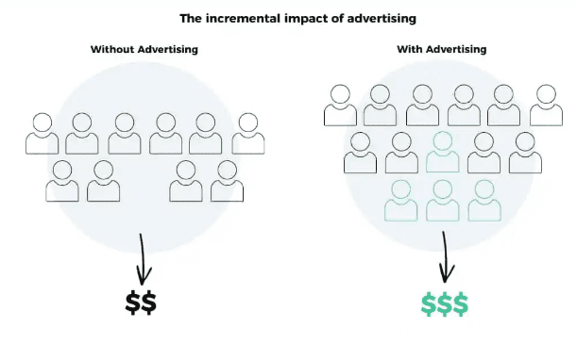
What is “Incremental Testing”
Incrementality is the increase or decrease in the desired outcome provided by marketing activity. The outcome could be profitability, revenues, or sales.
Incrementality testing Is a marketing measurement methodology for estimating the incremental sales impact of advertising. Incrementality tests provide an estimate for the actual revenue driven by a specific marketing activity, in contrast to revenue that would have occurred even without marketing or revenue driven by other marketing activities.
Notes:
Incrementality in marketing is specifically necessary for channels where ad impressions are challenging to map and measure, like social channels such as Facebook, Snap, Pinterest, and more. Key output of incrementality tests:
Incremental ROAS for the tested marketing activity, and
A measure of confidence capturing the quality of the test.
"Algorithmic platforms": This refers to ad networks (like Meta or Google PMax) whose primary goal is to get users to click or convert, because that is how they make money.
"Divergent Delivery": This means the algorithm does not show ads equally. As soon as a test starts, the algorithm watches who engages with Ad A and who engages with Ad B. It then diverts delivery, sending Ad A only to people it thinks will like Ad A, and Ad B only to people it thinks will like Ad B.
"Unobservable mixtures of users": Because the platform's algorithm is a black box, the marketer has no idea who the algorithm decided to show the ads to.
"Breaching random exposure assumptions": For an A/B test to be mathematically valid, the audience for Ad A and the audience for Ad B must be identical in every way. Because the algorithm diverted the traffic, the audiences are no longer identical. Therefore, the test is ruined.

Slide 31
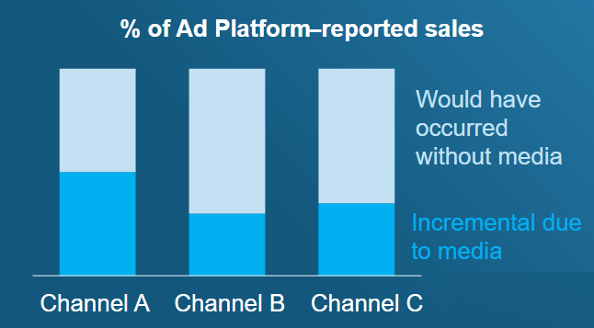
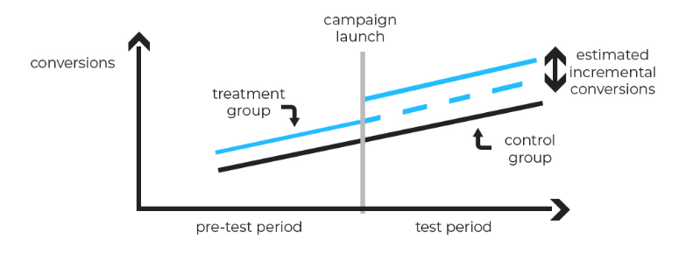
How does Incremental Testing Works
Incrementality testing covers various experimentation methods, such as Conversion Lift and Geo Experiment. All of them operate on the fundamental principle of test and controlled experimentation.
Data scientists divide their target audience into two groups: a test group that receives the marketing intervention and a control group that doesn't. By measuring the difference in desired outcomes (typically sales and revenue) between these groups, you can estimate the incremental impact of marketing efforts.
Notes:
In a nutshell, lift analysis is a technique that compares users who receive a campaign vs. those who do not receive the campaign to gauge the better group off. This provides excellent insights into the effectiveness and impact of the campaign. Determining the lift through the use of a control group is the most effective way to determine the true impact of your ad campaign. The following are some of the ways lift analysis can help your business:
Determine whether your ad campaign is triggering short-term spikes in engagement or long-term increases in loyalty and app usage.
Determine the ROI of each marketing strategy,
Save valuable time and avoid targeting your campaigns in areas with high clicks but low sales.
Track repeat conversions instead of one-time conversions

Slide 32
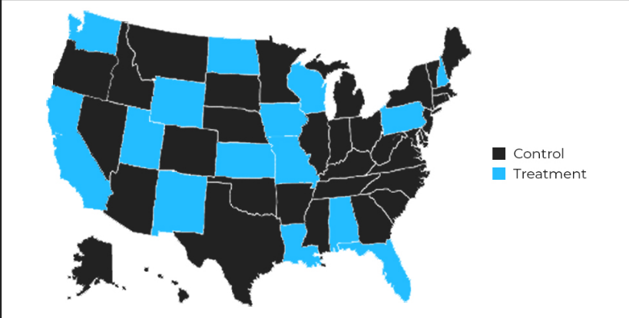
What is Geo Experiment Testing
GeoLift experiments are a way to measure the effectiveness of marketing efforts in specific geographic locations. Unlike traditional metrics, Geo Experiment focuses on the incremental impact, answering the crucial question: Did our campaign make a real difference in these specific regions?
The experiment utilizes advanced synthetic control methods to deliver insights that help you make informed decisions established in incrementality and measure the true value of your marketing campaigns. It provides unmatched solutions for geo experimentation, spanning data ingestion, power analysis, and market selection to inference.
Notes:
GeoLift is a powerful lift measurement solution and an ideal tool to analyze your advertising strategies. It can help businesses gain greater insights and data-backed decisions while course-correcting their marketing methods. GeoLift is designed to be relevant in the ever-changing advertising ecosystem, thereby helping brands correctly quantify the effect of their marketing. In a nutshell, GeoLift delivers an effective way for brands to move ahead into the future and overcome typical marketing challenges common with traditional techniques

Slide 33
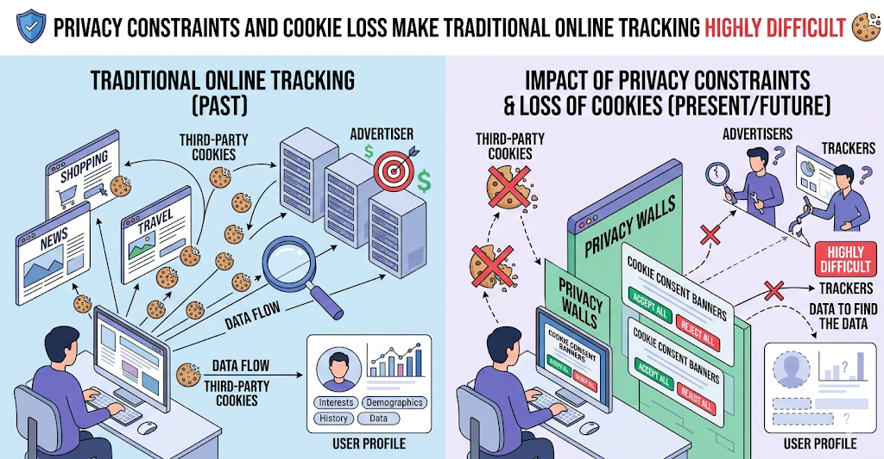
The Measurement Crisis
The Loss of Granularity
Technical challenges inhibit individual online tracking. Privacy constraints and the loss of cookies make traditional online tracking highly difficult.
Aggregated measurement methodologies are now mandatory.
Geo-experiments offer privacy-resilient, omnichannel measurement.
Notes:
The digital marketing industry is facing a measurement crisis. Increasing technical and privacy challenges are actively inhibiting marketers from tracking individual user behavior online. To survive, the industry must pivot to aggregated methodologies. Geo-experiments are the solution, as they rely on clustered geographic data rather than individual cookies, making them inherently resilient to privacy loss while providing true omnichannel measurement.

Slide 34
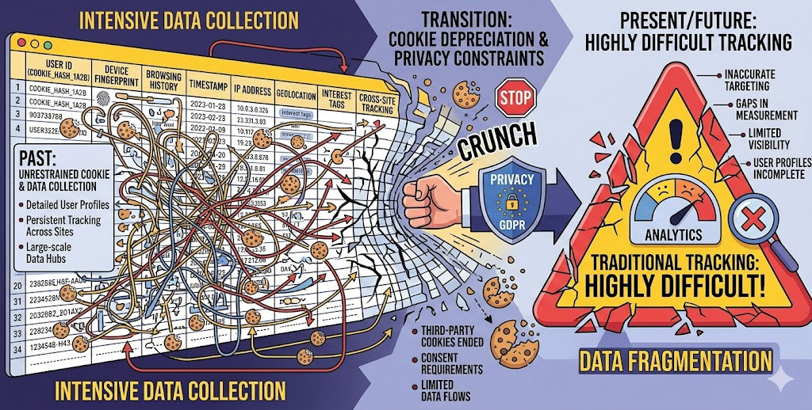
The Traditional Bottleneck
The Fragility of Legacy Systems
Fragmented workflows rely on static, highly fragile manual spreadsheets.
Analysts subjectively guess which test and control markets to pair together.
This manual process is deeply prone to human error and selection bias.
Misallocated ad spend costs agencies hundreds of thousands of dollars.
Notes:
Historically, executing these geo-experiments has relied on highly fragile, manual spreadsheet workflows. Analysts are forced to subjectively guess which markets to pair together. This manual process is deeply prone to human error and selection bias. A single formula error or poor market selection can completely invalidate a financial experiment, costing agencies hundreds of thousands of dollars in wasted ad spend.

Slide 35
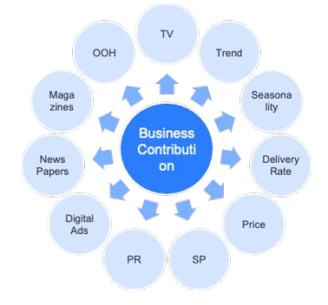
MMM Budget Allocation Recommendation
Media Mix Modeling Overview
MMM is a method for statistically estimating the business contribution of media and marketing activities without relying on cookies.
Conceptual Diagram of MMM
Benefits of Using MMM
MMM can estimate marketing effectiveness without relying on cookies
MMM can estimate marketing effectiveness in terms of business contribution such as sales volume or revenues.
MMM can estimate the effectiveness of various media, marketing activities, and external factors as well as digital advertising
Notes:
The "Black Box" refers to the process of making budget allocation recommendations.
Media Mix Modeling (MMM) is a statistical analysis technique that uses historical data to measure how different marketing channels (like TV, paid search, social media) and external factors (seasonality, promotions) collectively impact overall business results, such as sales or revenue, to optimize future spending and improve ROI. It's a "top-down" approach, analyzing aggregate data to understand the big picture, rather than tracking individual user journeys like attribution models.
How it Works
Data Collection: Gathers historical data on marketing spend (digital & offline), sales, promotions, pricing, and external trends.
Modeling: Uses statistical methods (like regression) to find correlations between marketing inputs (independent variables) and business outcomes (dependent variables).
Analysis: Determines the contribution of each channel and factor to total sales, accounting for lagged effects and synergies.
Optimization: Simulates different budget allocations to forecast the best mix for future campaigns.
Key Benefits
Holistic View: Provides a comprehensive understanding of all marketing efforts, online and offline.
ROI Measurement: Quantifies the return on investment (ROI) for different channels.
Budget Allocation: Informs where to best invest marketing dollars for maximum impact.
Predictive Insights: Helps forecast sales and plan future campaigns effectively.
Privacy-Safe: Relies on aggregated data, making it resilient to cookie changes and privacy regulation

Slide 36
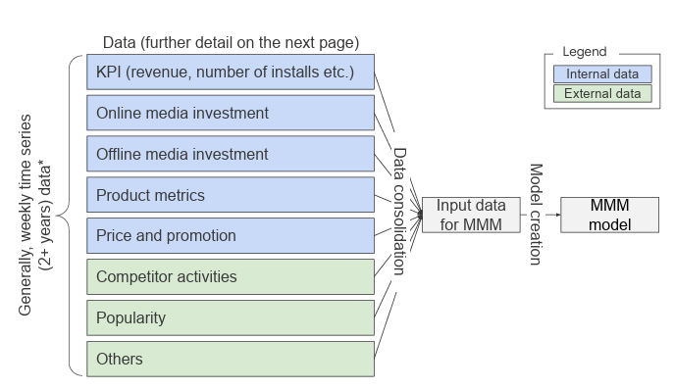
MMM Data Selection Overview
This image shows an overview of the data selection and consolidation process for media mix modelling. Models need to source various data across internal and external and online and offline sources.
All data needs to be time-series data (generally daily or weekly) with the same granularity. If a modeller wants to create a weekly-level MMM, then all the data must also be at a weekly level. Thus, input data granularity constrains the model granularity.
Generally, data collection and consolidation and its automation (if a modeller intends to use the model continuously) take several weeks.

Slide 37
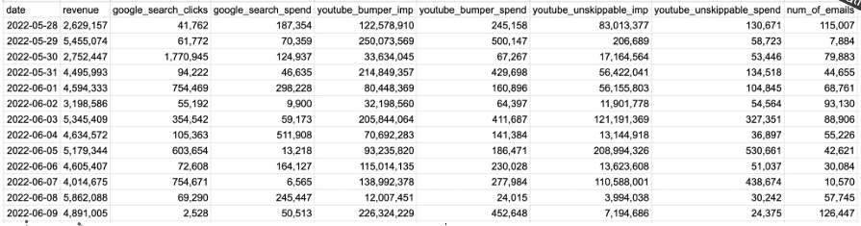
Example MMM Input Data
Impressions, clicks, and spend amount data by media.
Spend: Use each media’s spend as the media variable in the MMM model
Impressions: Use each media’s number of exposed ad impressions as a media variable. Example viewable impressions,in LinkedIn
Clicks: Use each media’s attributed number of clicks (number of clicks after seeing ads) as media variable in the MMM model
Date: Daily data for daily level MMM. Weekly data for weekly level MMM.
KPI: Revenue amount, Sales amount.
Organic Variables:
Number of Emails: Media utilization without associated expenditure
Notes:
Impression is generally a good choice to describe ads exposure regardless of the path (see ads -> offline purchase, see ads -> click -> purchase etc.).

